Slide 1

Project 1 – Designing a Sales Dashboard using Microsoft Excel
Submitted By: Epsa Kapur

Slide 2

Objectives
To Use Excel to analyze the sales based on various product categories.

Slide 3
Description
The dataset in file E-Commerce Dashboard dataset.xlsx contains sales data for different product categories. The following are the features in the dataset.
Order ID | Unique Order ID of a product
Order Date | Order Placement Date
Ship Date | Shipment Date of the placed order
Aging | Used to Create Histogram Bin
Ship Mode | Shipment mode of placed order
Product Category | Product Category
Product | Name of the Product
Sales | Sales Amount
Quantity | The amount or number of a material
Discount | A deduction from the usual cost of something
Profit | A financial advantage or benefit
Shipping Cost | The amount required to ship the placed order
Order Priority | Precedence of placed order
Customer ID | Unique Customer ID
Customer Name | Name of the Customer
City | Unique City Name
State | Unique State Name
Country | Unique Country Name
Region | Especially the part of a country
Months | The month of placing the order

Slide 4

Tasks
The following project tasks were performed in Excel:
Used the saved Sample E-Commerce database and prepared a table of Sales and Profit month-wise in a working sheet.
Prepared the sales table region-wise in the working sheet.
Created User Control Combo box for Product Category.
Created a Column Chart of the month-wise table and region-wise table.
Created a sales dashboard.

Slide 5
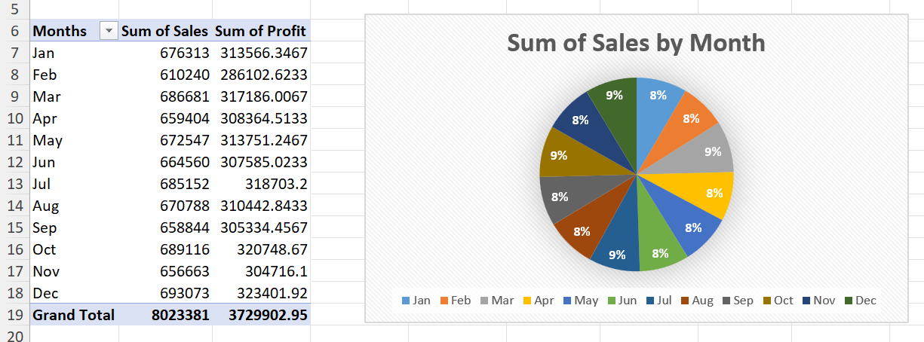
Task 1 - Sales and Profit month-wise

Slide 6
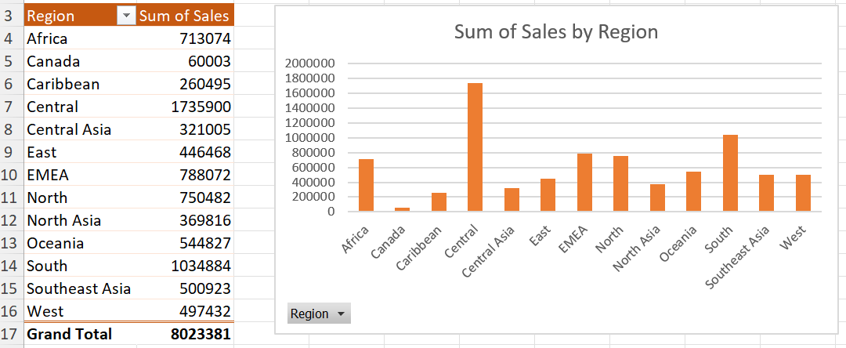
Task 2 - Sales by Region

Slide 7
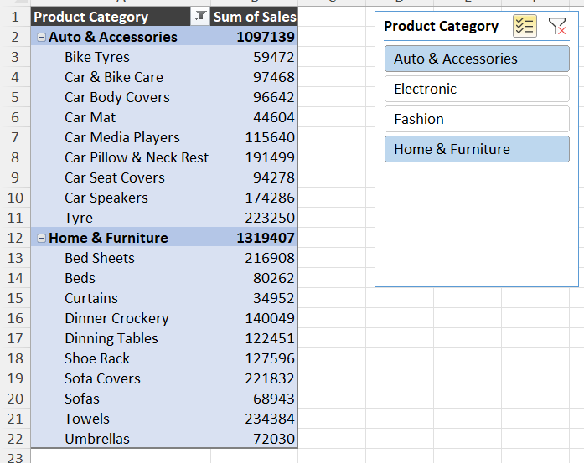
Task 3 -User-Control Combo Box for Product Category

Slide 8
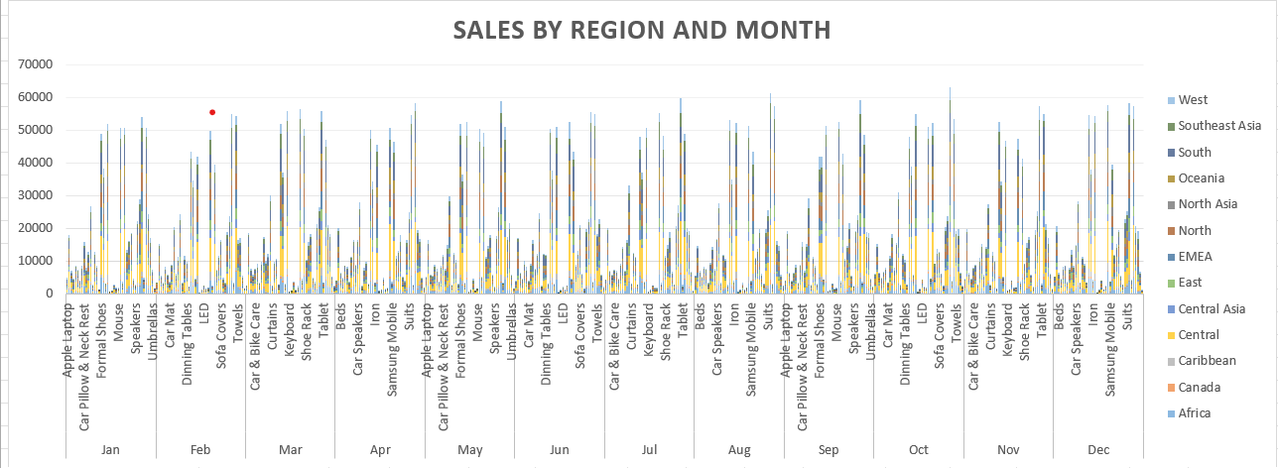
Task 4 – Column Chart for Sales by Region and Month

Slide 9
Task 5 – Sales Dashboard

